Slide 1

Political juggernauts : Quantitative analysis of candidates In the 2019 lok sabha Elections

Slide 2
Team lead id : D46810850476DAD97E741153D38A9851 Team id : Nm202309351

Slide 3
Team members – nm id
M.Mageshwari -D46810850476DAD97E741153D38A9851
K. Rajeshwari -A23B8C0F5AF741199974EED7695BBE6F
K. Nivetha -37BF235EDE7372D98E347C51E4E93D1B
T. Prithi -4F3BF5AC6FADB3DBAB149C5073FC315

Slide 4
Introduction
The Lok Sabha is composed of representatives of people chosen by direct election on the basis of Universal Adult Suffrage. The Constitution of India allows for a maximum of 550 members in the House, with 530 members representing the States and 20 representing the Union Territories. The 17th Lok Sabha was formed by the members elected in the 2019 Indian general election. Elections, all across India, were conducted in seven phases from 11 April 2019 to 19 May 2019 by the Election Commission of India. The Bharatiya Janata Party received 37.36% of the vote, the highest vote share by a political party since the 1989 general election, and won 303 seats, further increasing its substantial majority. In addition, the BJP-led National Democratic Alliance (NDA) won 353 seats

Slide 5
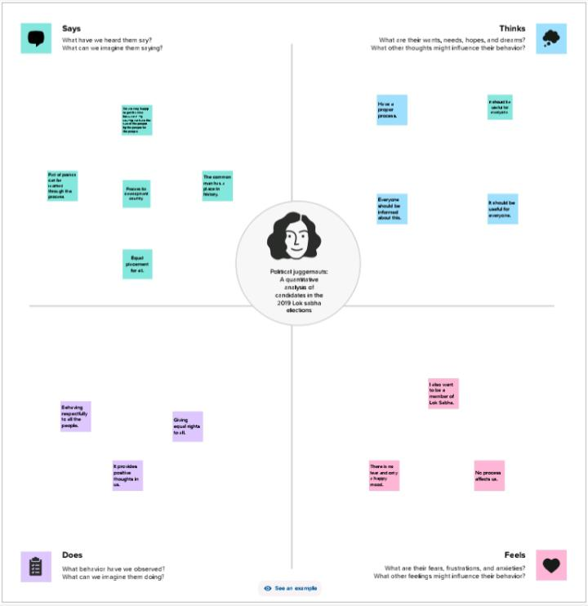
Problem defining and design thinking: Empathy map

Slide 6
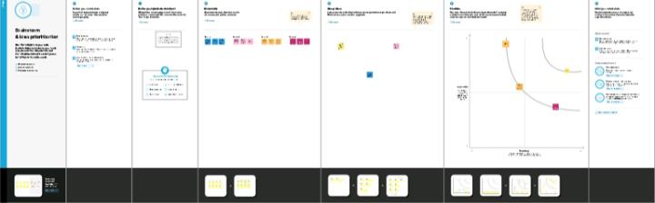
Brain storming

Slide 7
Git hub
Empathy map and Brainstorming was uploaded in Git hub.

Slide 8
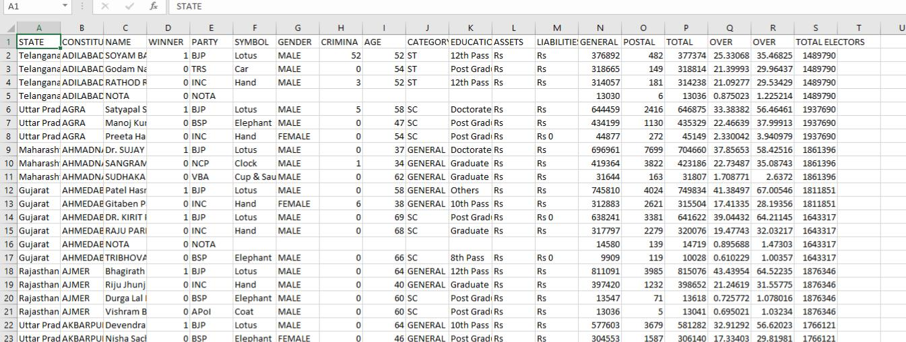
Data
The second step of the project is the data collection and extraction from the data base. The data sheets is collect the NM portal.

Slide 9
Data Visualization
Data visualisation is the process of creating graphical representations of data in order to help people understand and explore the information. The goal of data visualization is to make complex data sets more accessible, intuitive and easier to interpret. By using visual elements such as charts, graphs and maps. It can help people quickly identify patterns, trends in the data.

Slide 10
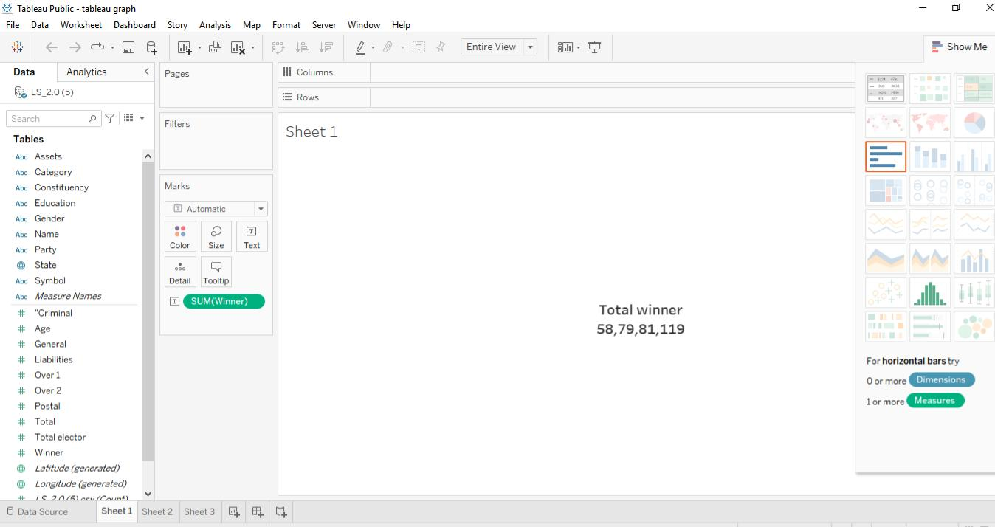
kpi’s

Slide 11
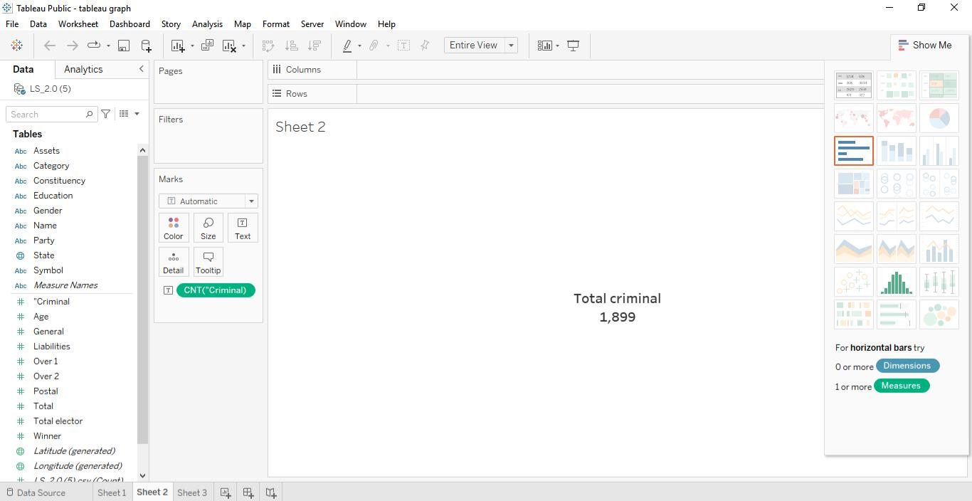

Slide 12
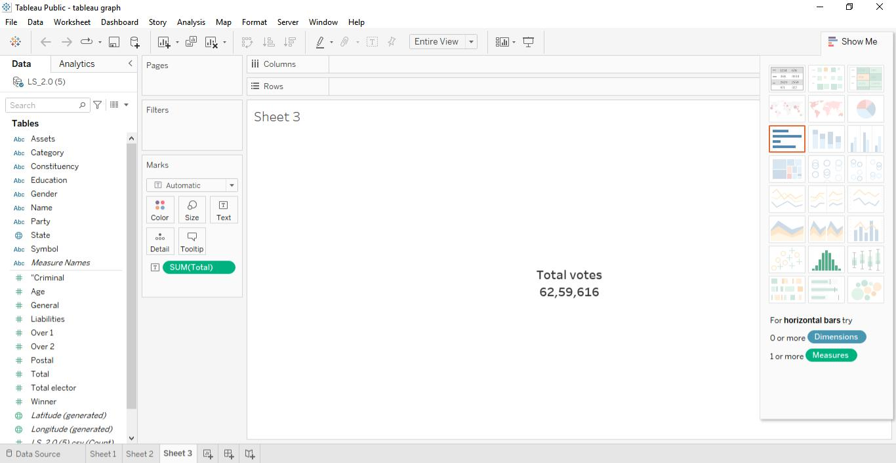

Slide 13
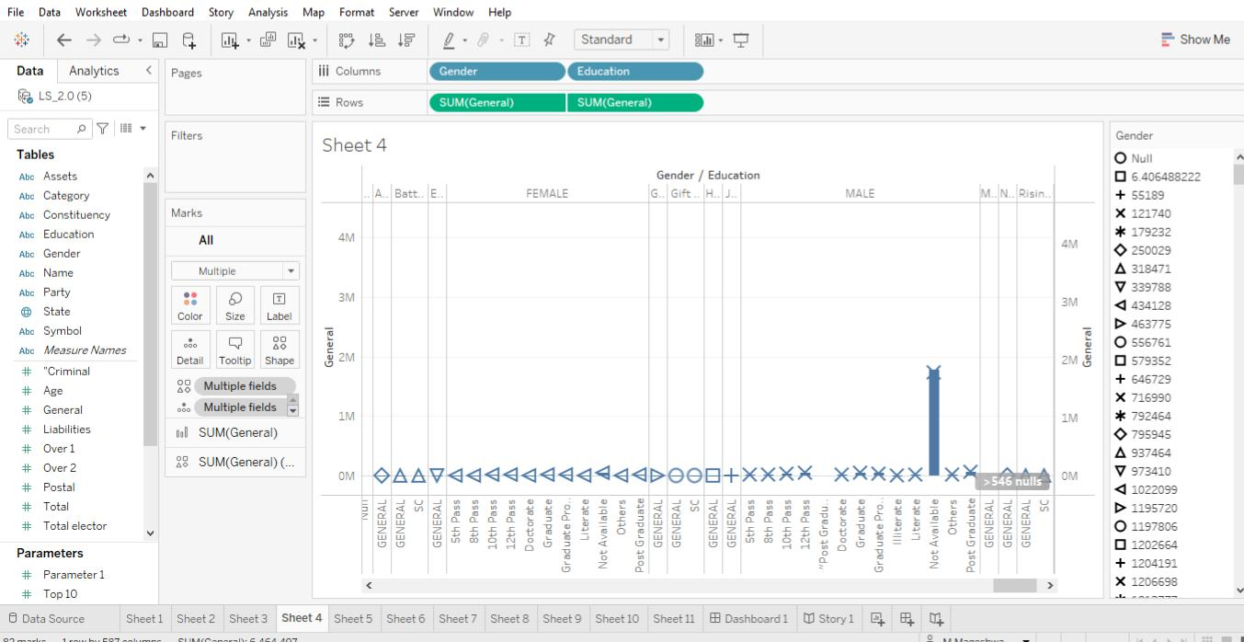
Gender and educational wise general votes

Slide 14
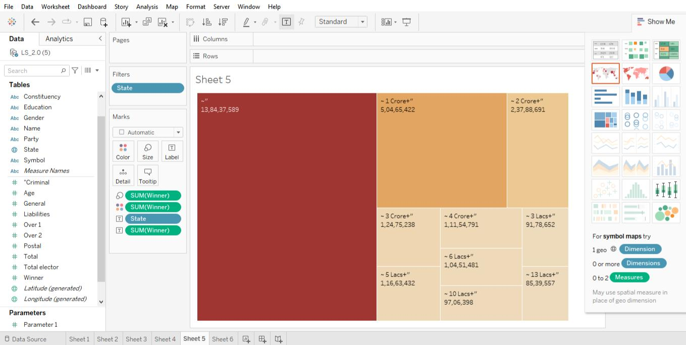
State wise winner

Slide 15
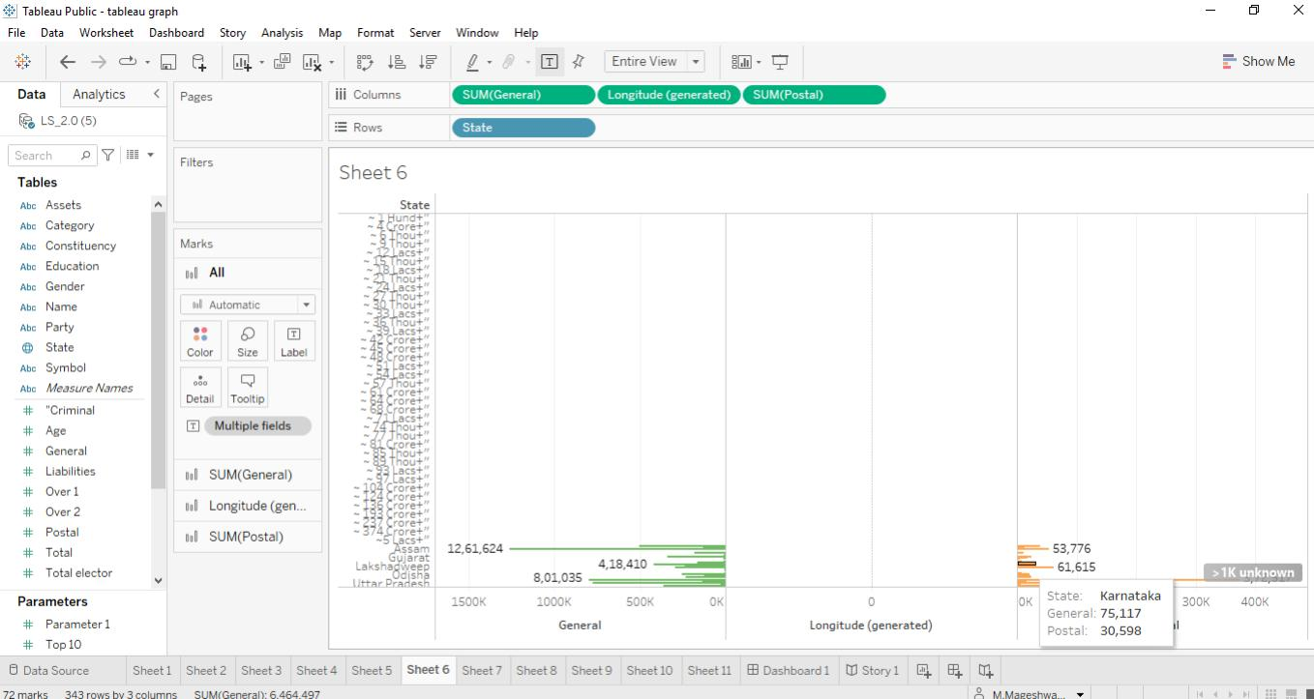
State wise general votes and postal votes

Slide 16
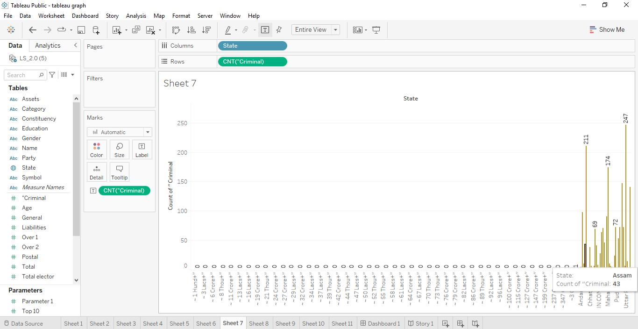
State wise criminal cases

Slide 17
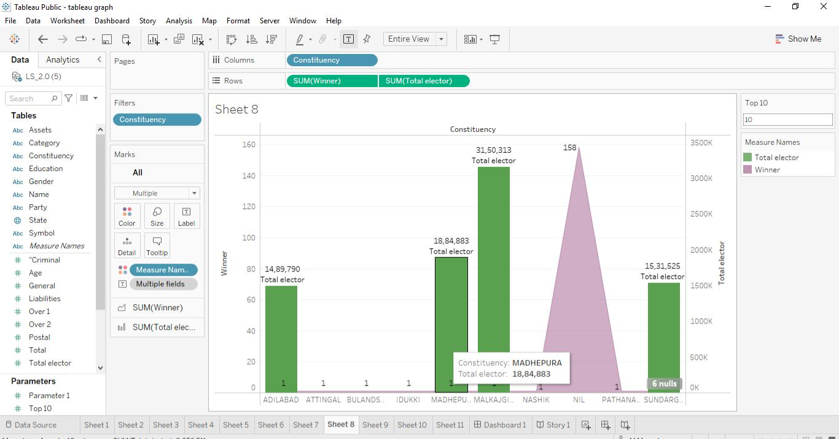
Constituency wise winners and electors

Slide 18
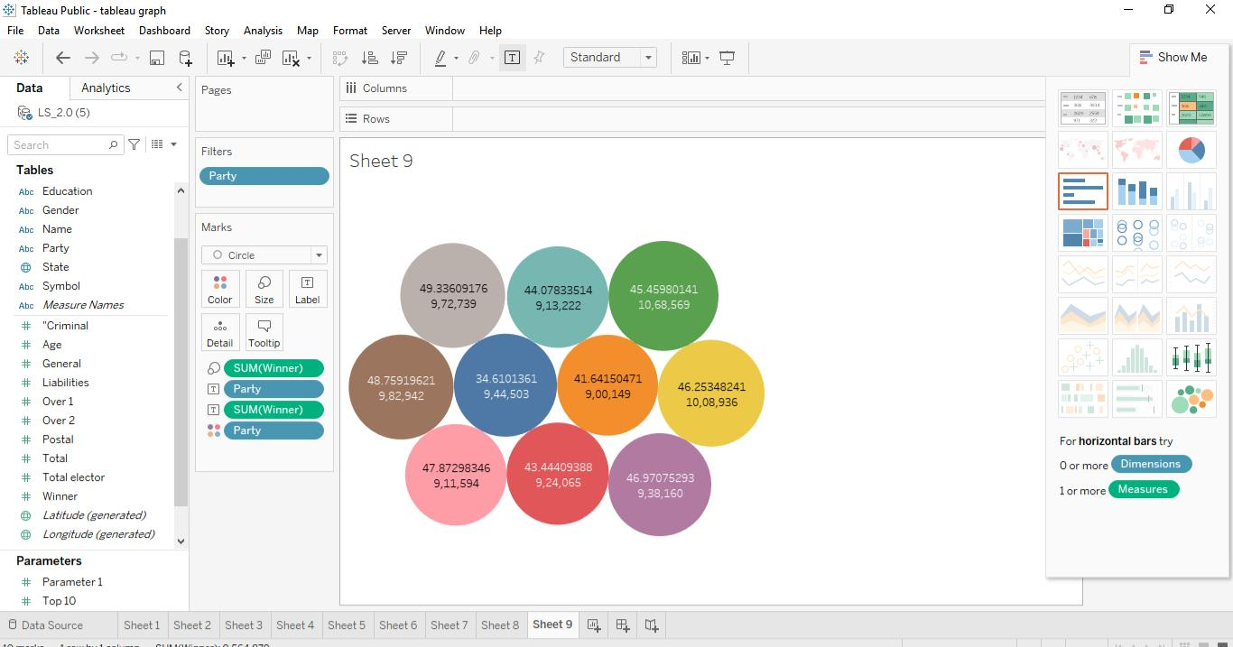
Party wise winner

Slide 19
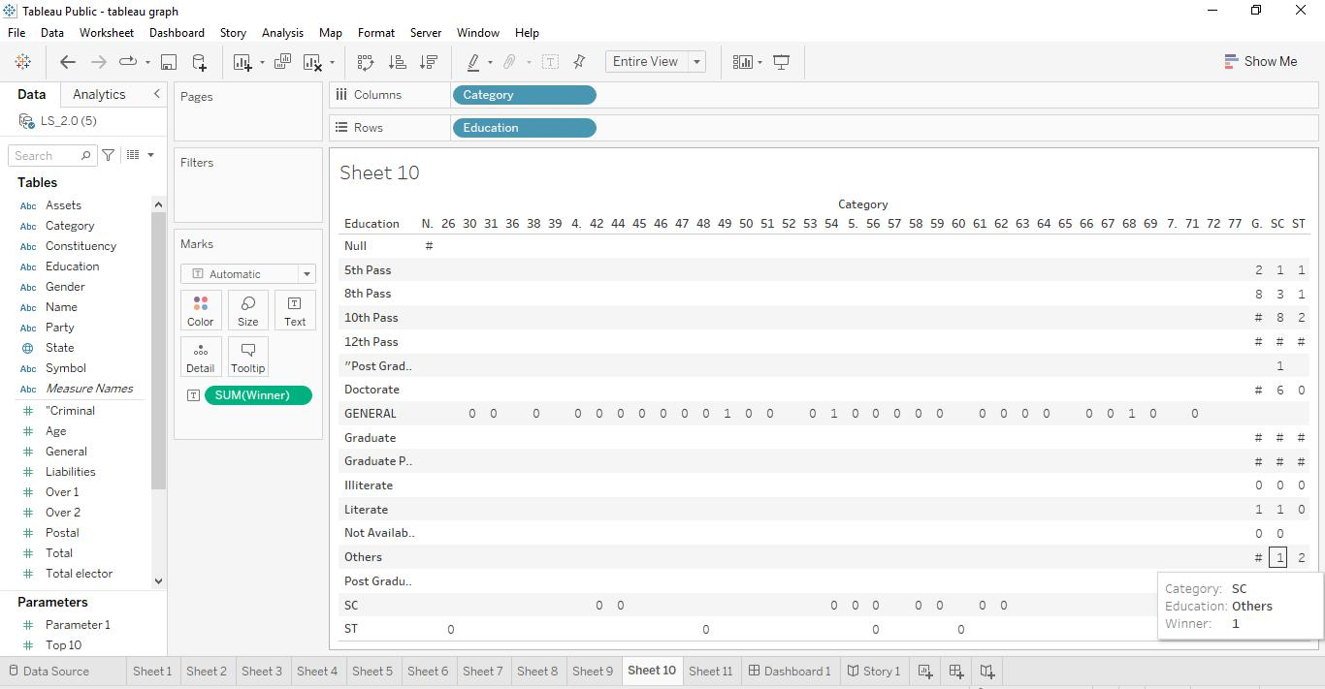
Winners by education and category

Slide 20
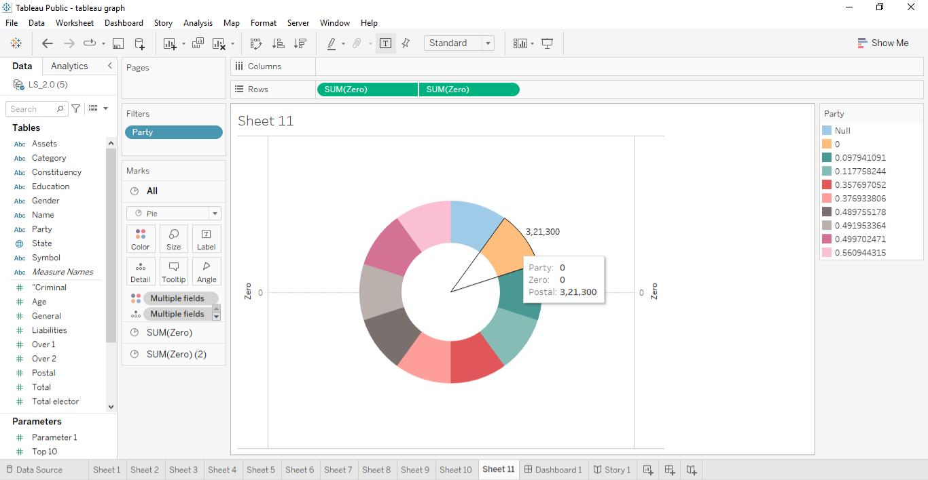
Party wise postal votes

Slide 21
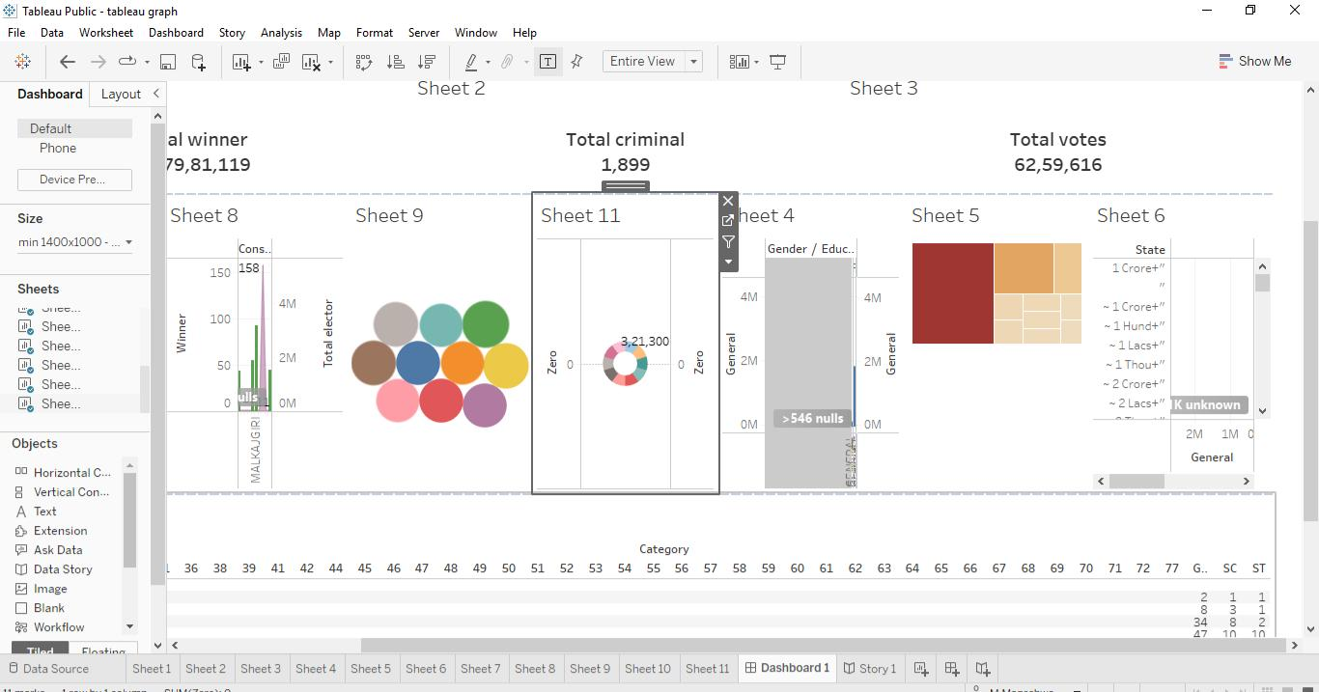
Dashboard

Slide 22
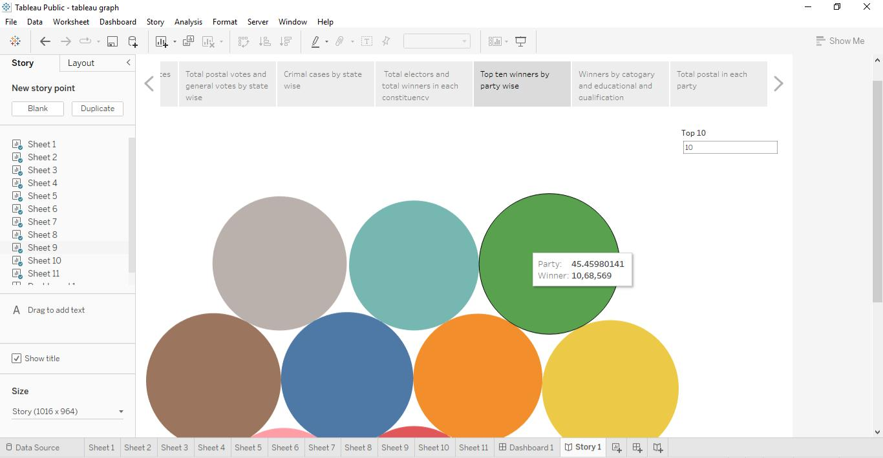
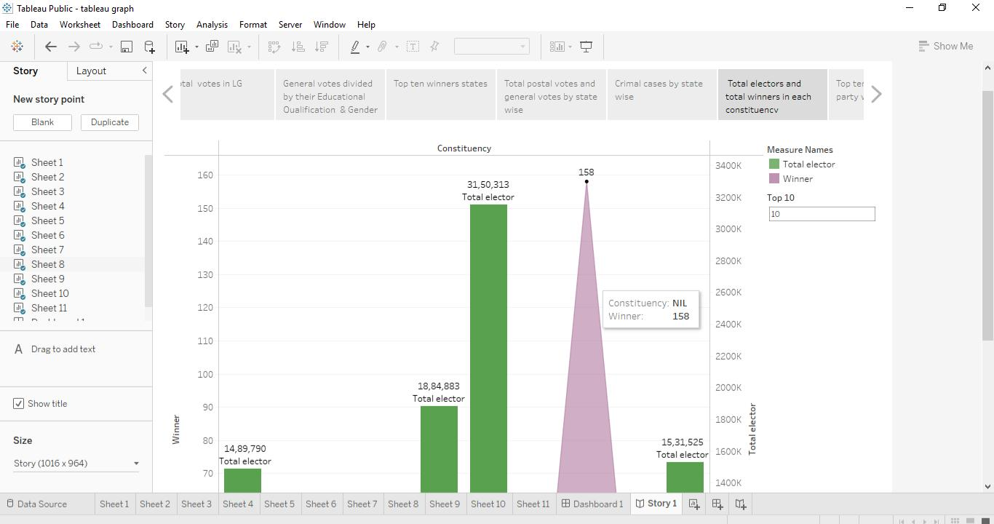
Story

Slide 23

Published
Dashboard and story was published in tableau puplic.

Slide 24
Thank you...

